Slide 1

Sweet Karoline’s Cakes – Iteration 5
By: Silver Soul
Benjamin Benoit, Nick Gay, Matt Holston, Alex Mattingly, Adam Schweitzer, and Nick Taylor

Slide 2
Overview
Class Diagram
Windows Navigation System
Screen Layouts
Database Design (ERD)
Prototypes

Slide 3
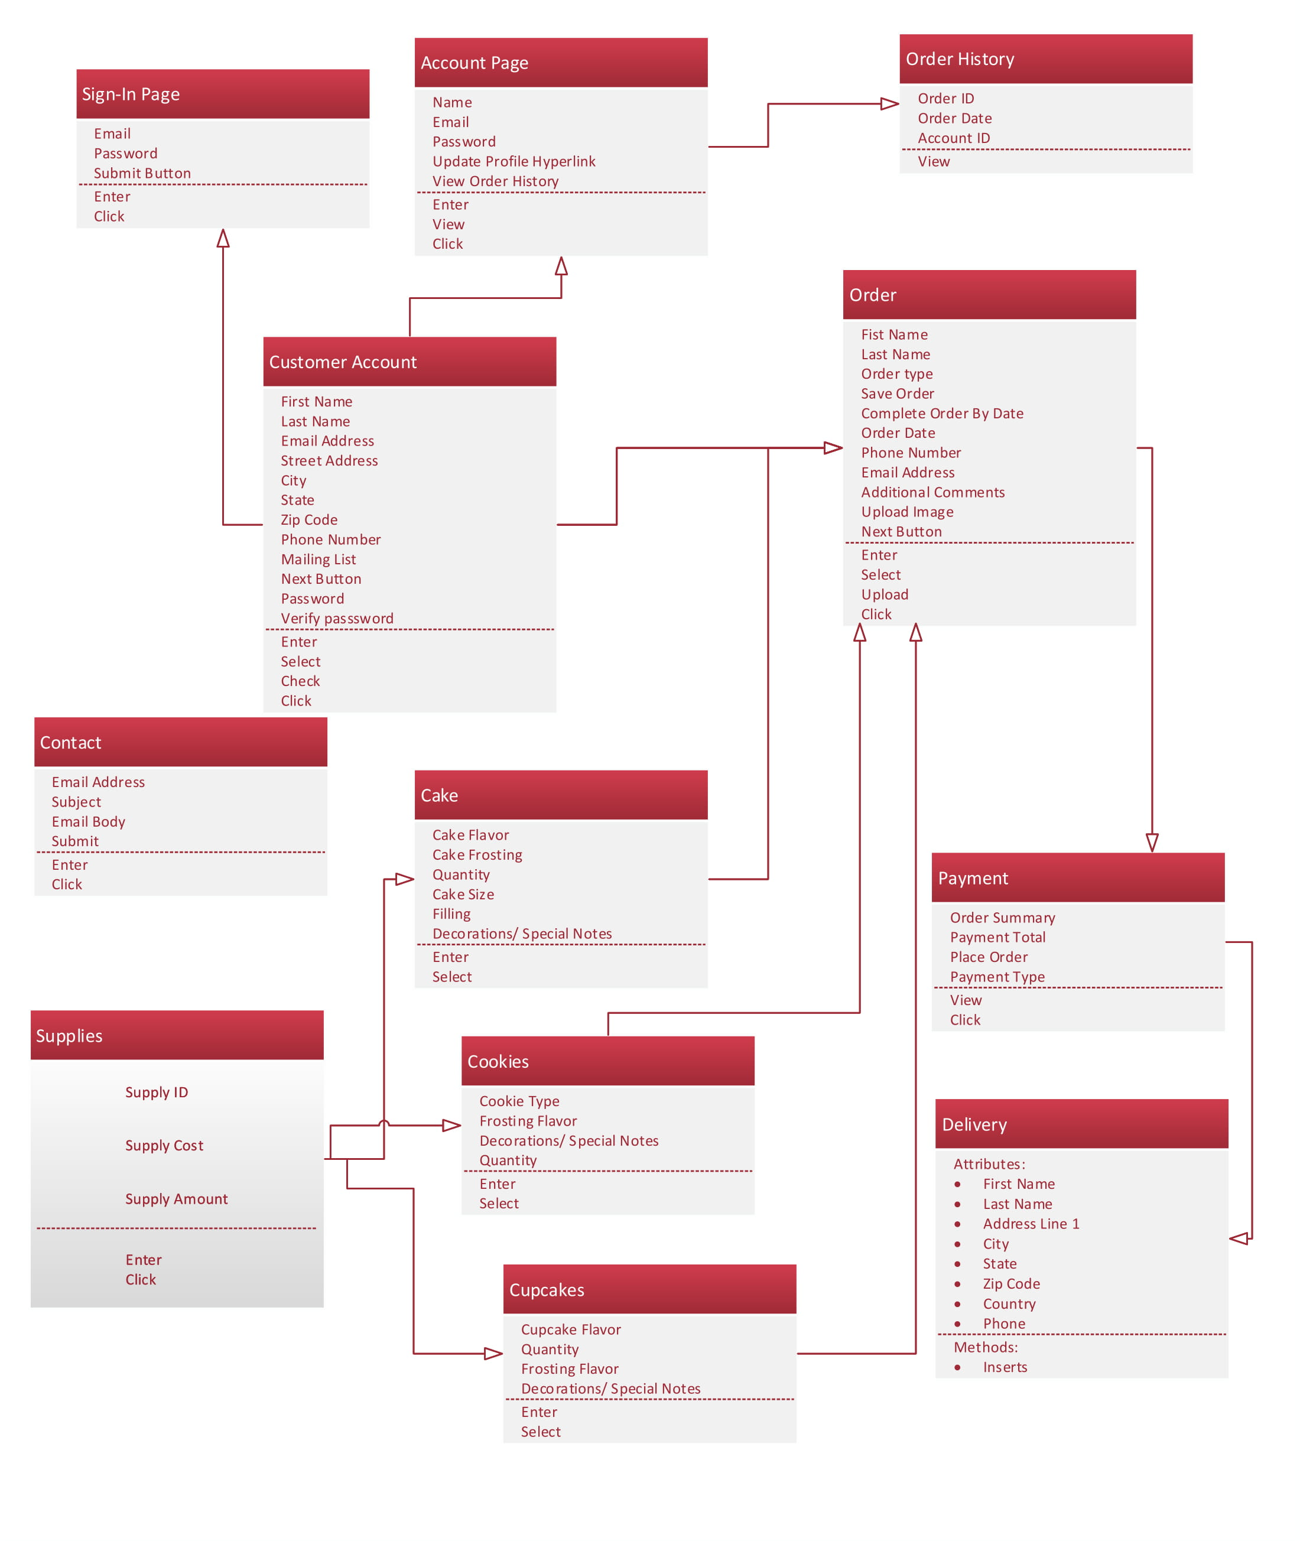
Class Diagram
Shows relevant classes derived from high level use cases and prototypes.

Slide 4
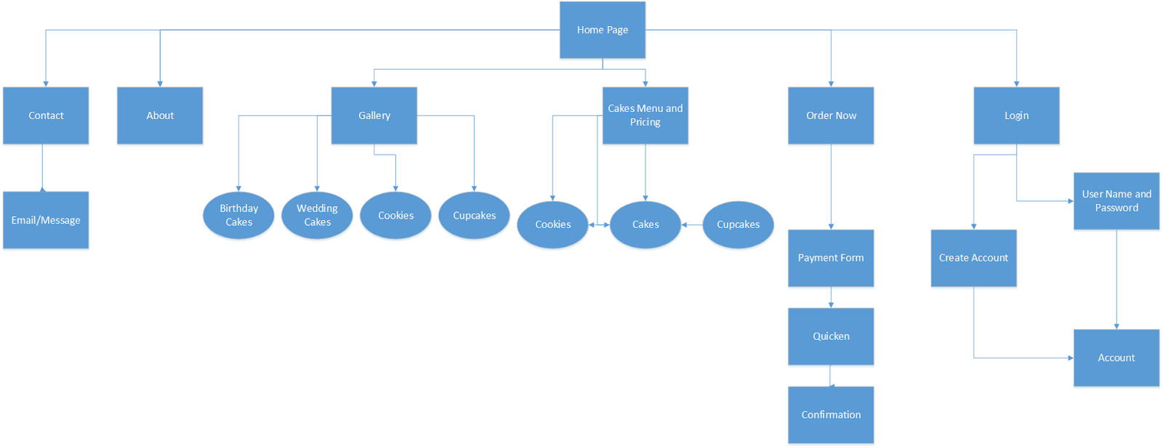
Windows Navigation System
Shows how the end user will navigate through the website/system.

Slide 5

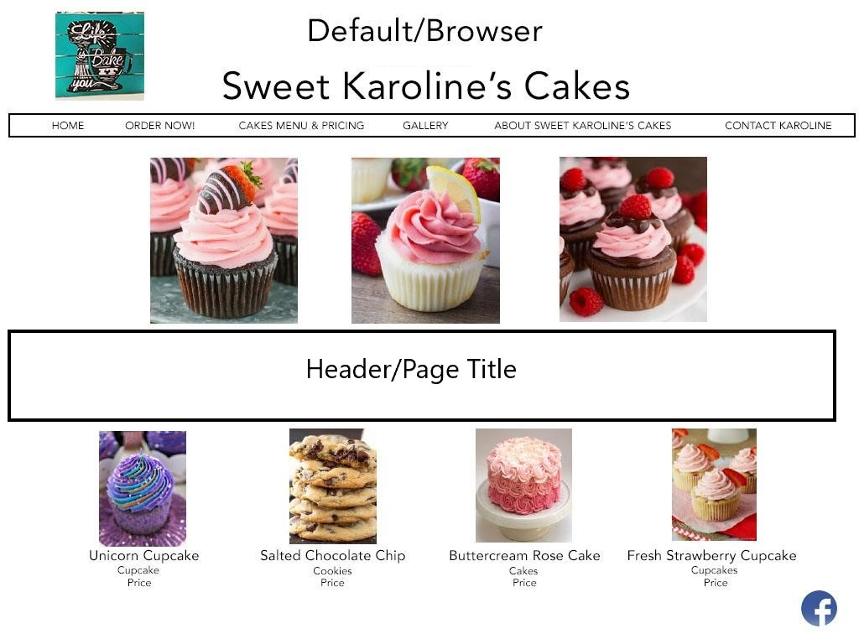



Screen Layout – Desktop Web Browser
Depicts the design and layout of the main page of SKC for a desktop user.

Slide 6
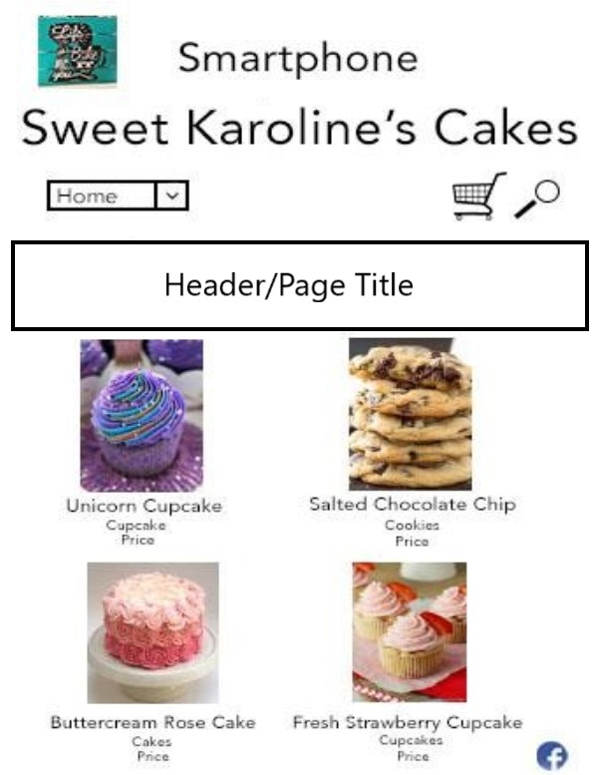
Screen Layout - Smartphone
Depicts the design and layout of the main page of SKC for a smartphone user.

Slide 7
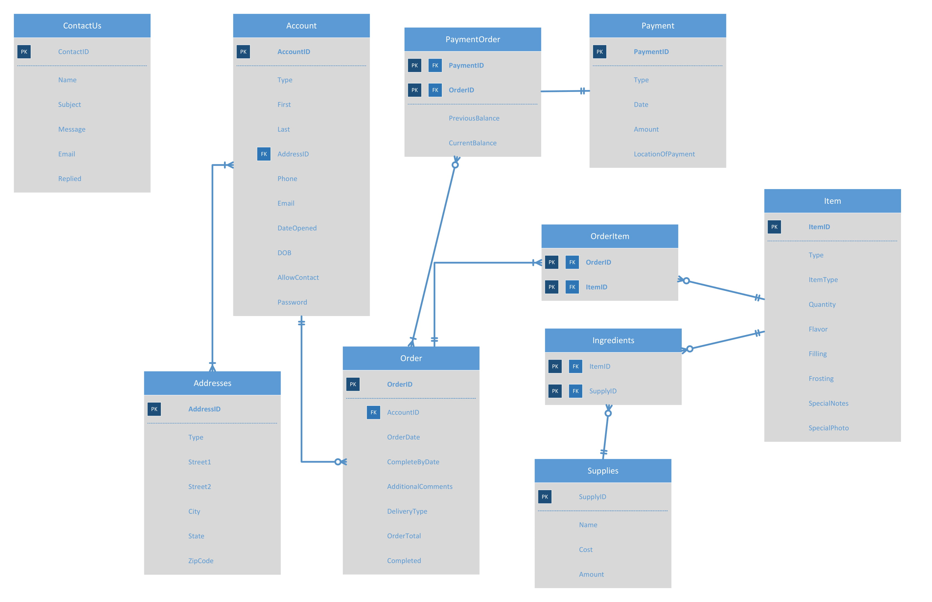
Database Design (ERD)

Slide 8
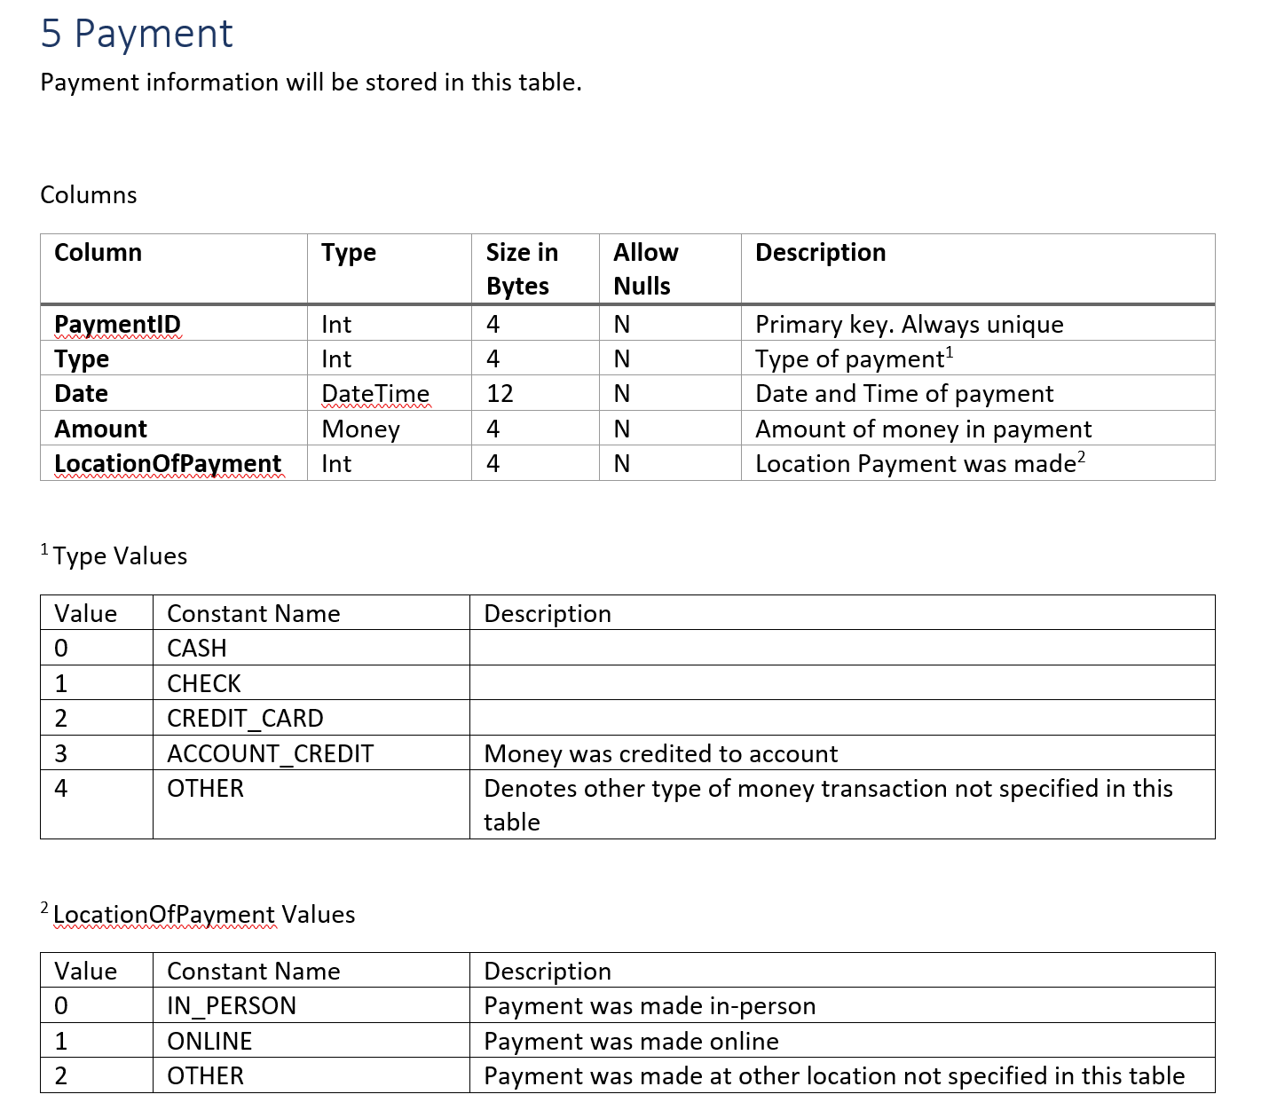
Data Dictionary

Slide 9
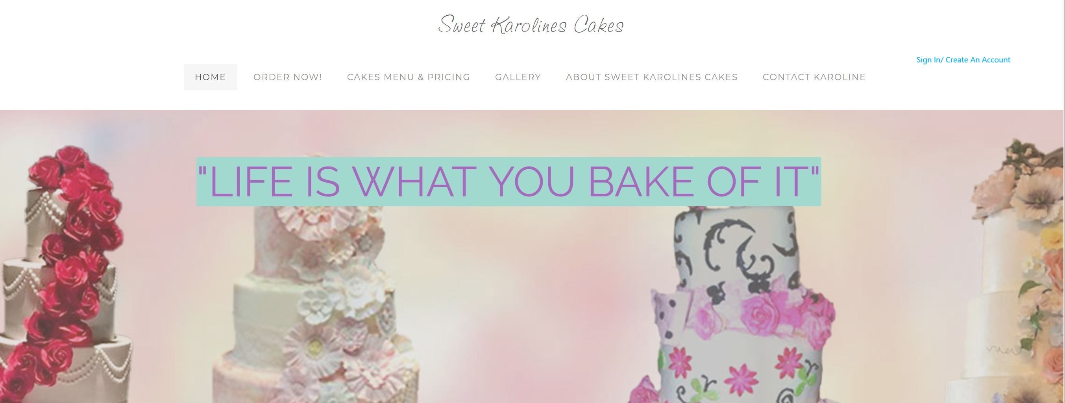
Prototype - Homepage

Slide 10
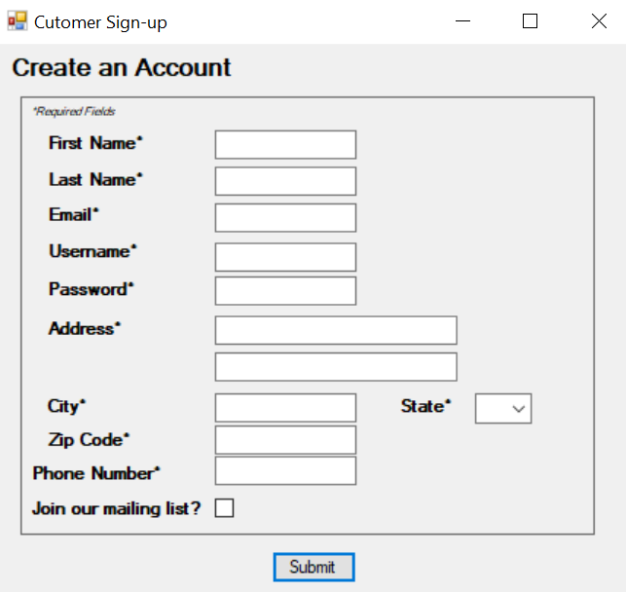
Prototype – Account Sign-Up

Slide 11
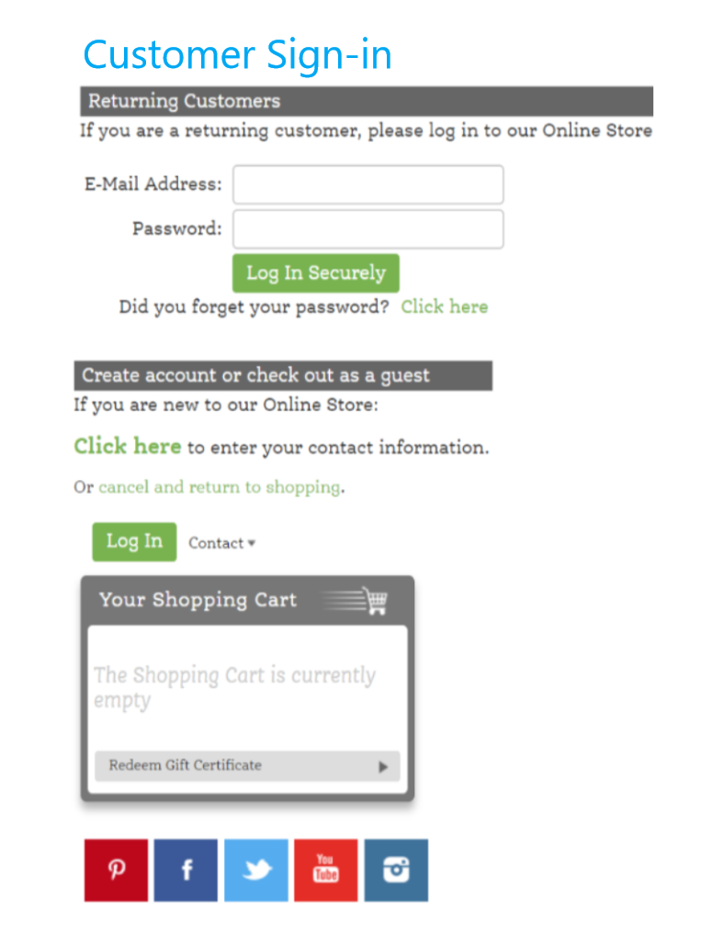
Prototype – Sign in

Slide 12
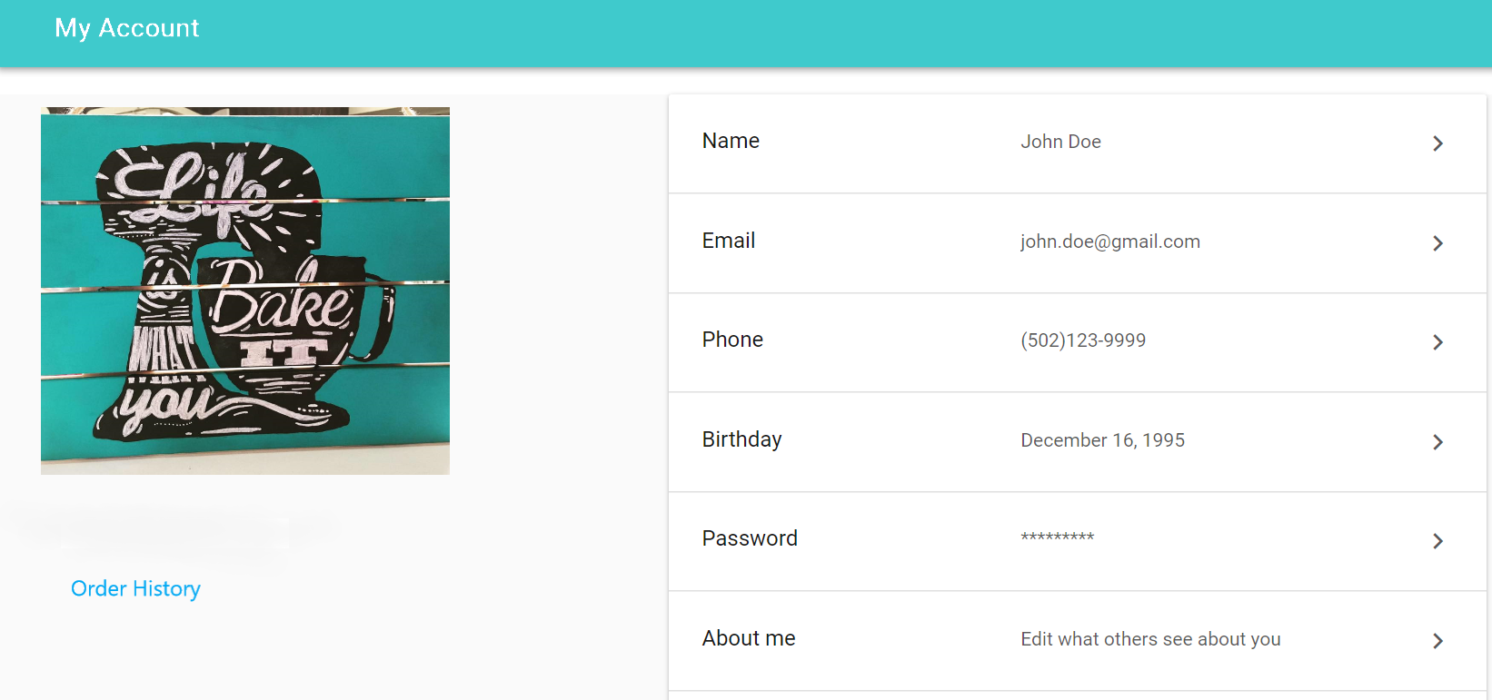
Prototype – Customer Acct Page

Slide 13
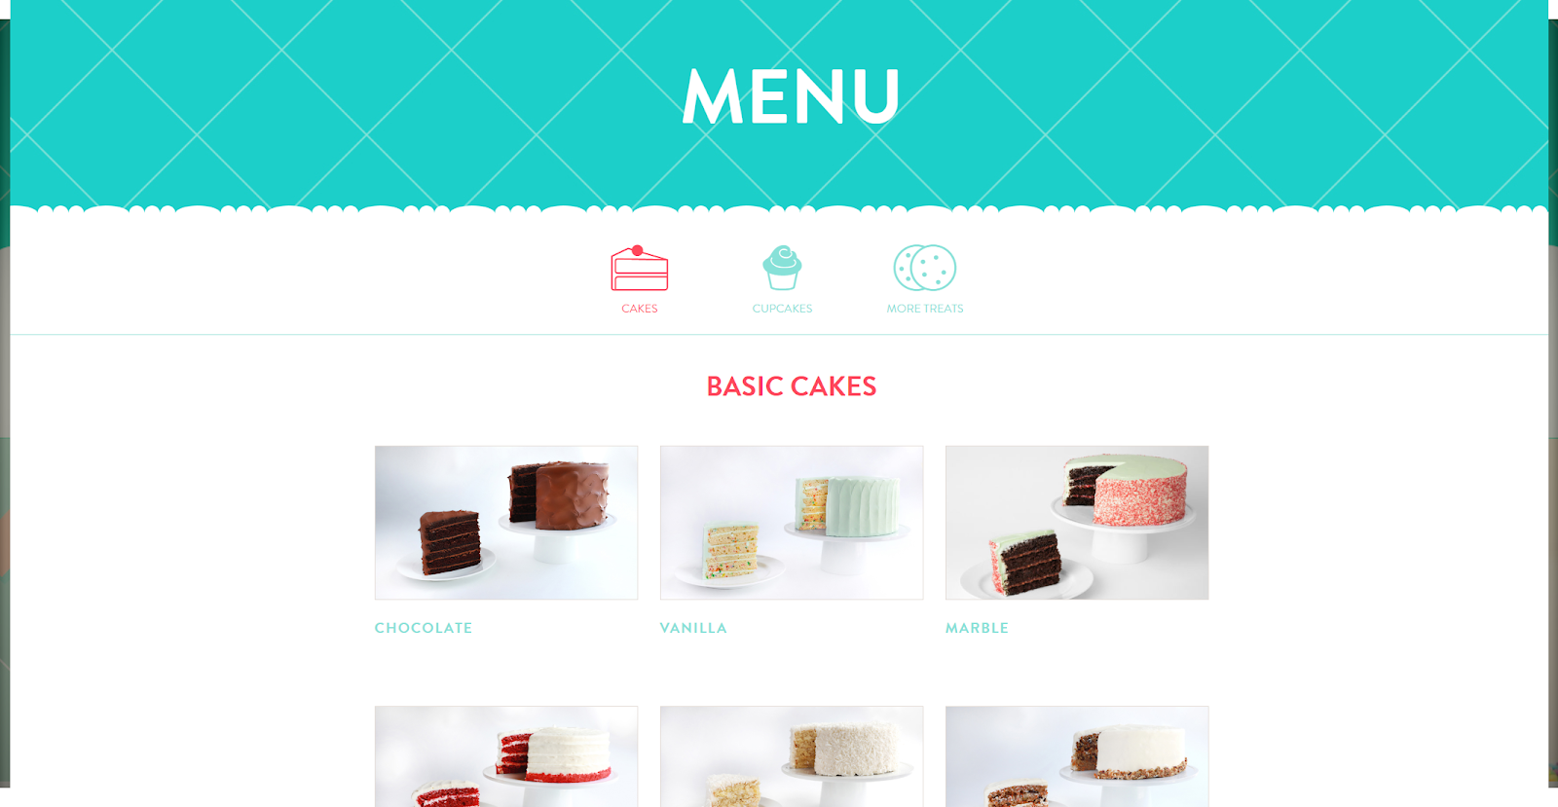
Prototypes - Menu

Slide 14
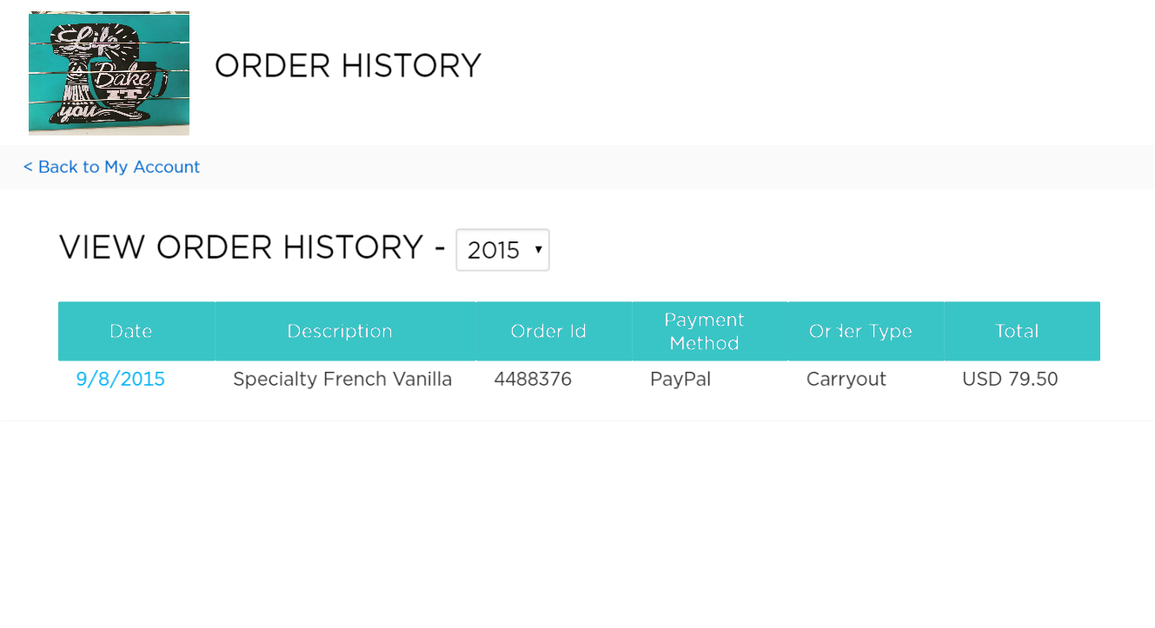
Prototype – Order History

Slide 15

Questions?

